Slide 1


Introduction to
Spring Cloud Services

Slide 2
Today’s Flow
Trend toward Microservices
Netflix OSS & Spring Cloud
Cloud config with Spring Cloud Config & Spring Cloud Bus
Service discovery with Eureka
Client side load balancing with Ribbon
Fault tolerance with Circuit breakers using Hystrix
Hystrix stream aggregation

Slide 3
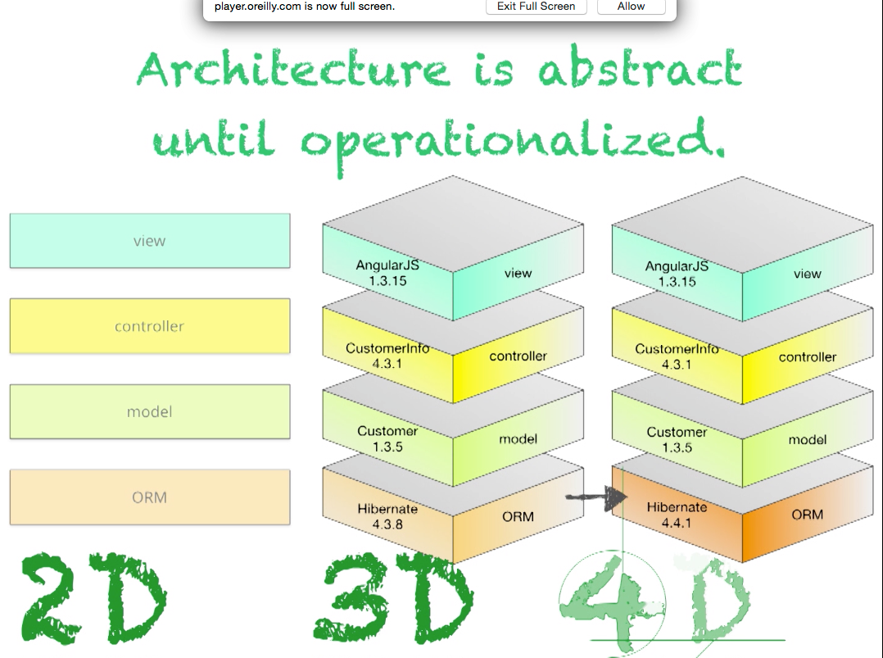
Moving from 3D to 4D
By Neal Ford (Thoughtworks)
Notes:
https://player.oreilly.com/videos/9781491932636

Slide 4
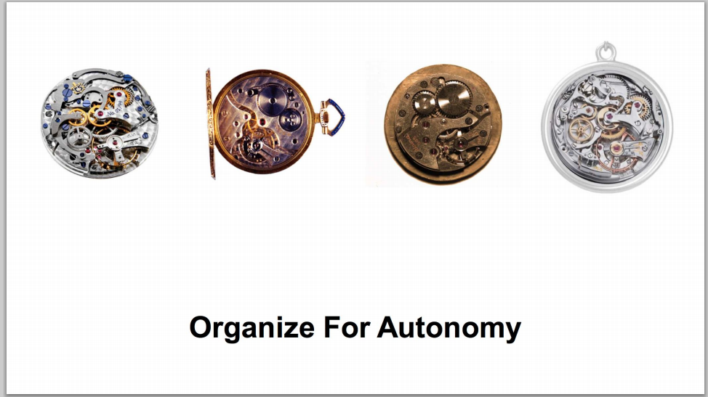
New 4D Focus: Accelerate Innovation
Lowers Cost of Failure
Reduces Friction
Speeds Iteration
High Frequency of Deployment
The right org/size, api contracts, & expectations
Amazon Summit 2014
Notes:
http://media.amazonwebservices.com/jp/summit2014/TE-01.pdf
Add conways law and inverse conway maneuver

Slide 5
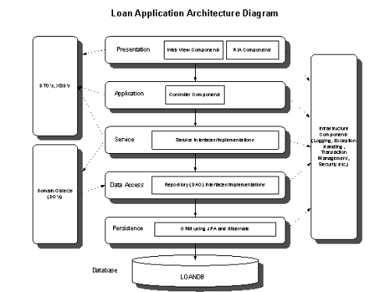
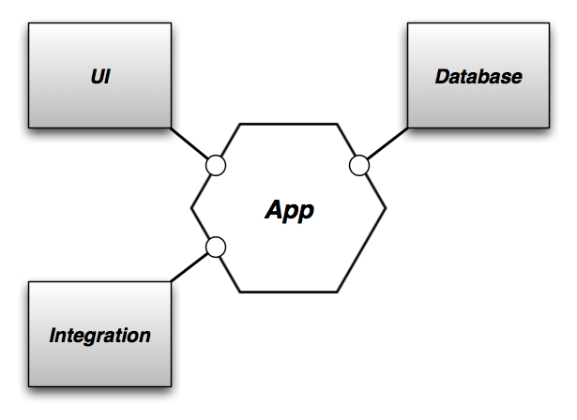
“Life Preserver” Rather than a “Raft”
Hexagonal Architecture by Alistair Cockburn - 2005

Slide 6
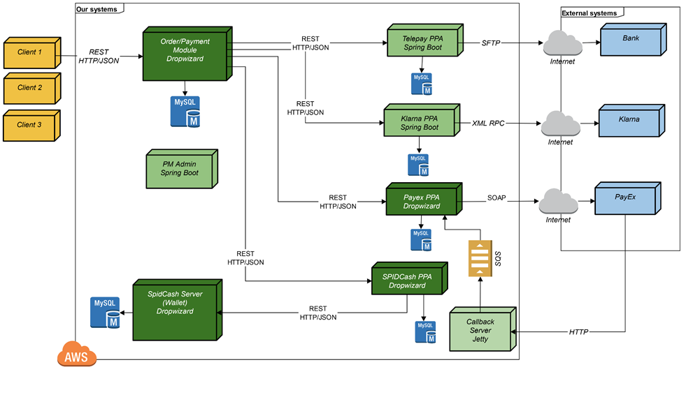
Architecture built for Autonomous Change
Comparison of Spring and Dropwizard - 2015
Notes:
http://www.schibsted.pl/2015/07/spring-boot-and-dropwizard-in-microservices-development/

Slide 7


Cloud Native Architectures
Light Side of the Cloud
Scalability
High Availability
Velocity: Continuous Delivery
On-Demand Provisioning

Slide 8

Cloud Native Architectures
Dark Side of the Cloud: Finding Services
Where are you?
Over here!

Slide 9
Cloud Native Architectures
Dark Side of the Cloud: Managing Configuration Differences
I’m a little different!
So am I!
Me too!
Dev
QA
Prod

Slide 10
Cloud Native Architectures
Dark Side of the Cloud: Handling Failure
Uh oh!
Uh oh!
I need you!
I need you!
I need you!
Uh oh!
I broke!

Slide 11
Cloud Native Architectures
Dark Side of the Cloud: Following call graphs
WHAT’S GOING ON?!?

Slide 12
Cloud Native Principles
Principles establish a contract between cloud native apps and the underlying platform
Cloud native apps recognize they are ephemeral, and minimize dependencies on the underlying platform
The Twelve-Factor App (http://12factor.net) is a popular and important set of principles
Twelve Factors include Dependencies, Config, Processes, and Disposability
APPS
Contract
Cloud Platform
Notes:
References:
http://12factor.net/
Architectural and development practices, that ensure an optimal experience on a cloud platform.

Slide 13

Netflix Cloud Libraries
Netflix needed to be faster to win / disrupt
Pioneer and vocal proponent of microservices – the key to their speed and success
Netflix OSS suppplies parts, but it’s not a solution
Notes:
Have to be able to scale in response to surges, add new features rapidly. Can’t go down for maintenance/upgrades.
NetFlix, an undisputed business & technology leader
34% of peak N. American internet traffic from 6-9pm
If speed was why they won, microservices was how
They pioneered / began to popularize micro service concept
All they had was Amazon EC2 back then
They had to invent a distributed platform, cloud native platform with PaaS – like features
They had to invent microservice infrastructure at the application level
All before writing one line of code that relates to the application you and I know as Netflix

Slide 14

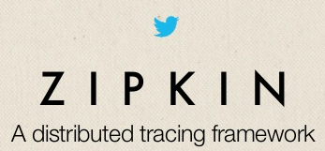
Open Source Cloud Libraries
Companies like Twitter, Facebook, and Hashicorp have open-sourced other cloud infrastructure libraries
Complementary and competing solutions from top technology companies form a bazaar of ideas

Slide 15

Spring Cloud
Provides easy developer access to a curated selection of open source cloud infrastructure libraries
Spring Cloud API encapsulates access to underlying libraries, allowing pluggable implementations.

Slide 16
Spring Cloud
Additional capabilities include Cloud Connectors and Config Server
Brings the Spring philosophy of convention over configuration, opinionated defaults, and developer simplicity

Slide 17
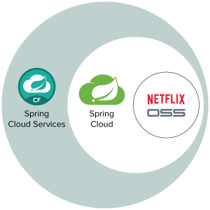
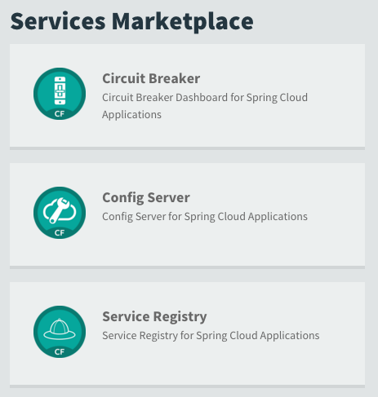
Spring Cloud Services

Slide 18




Spring Cloud Services
Service Registration and Discovery via Netflix OSS Eureka
Registration via CF Route
Service Registry
Git URL for Config Repo provided via Service Dashboard (post-provisioning)
Single tenant, scoped to CF space
Config Server
Spring Cloud
Services
Netflix OSS Turbine + Hystrix Dashboard
Aggregation via AMQP (RabbitMQ)
Circuit Breaker

Slide 19
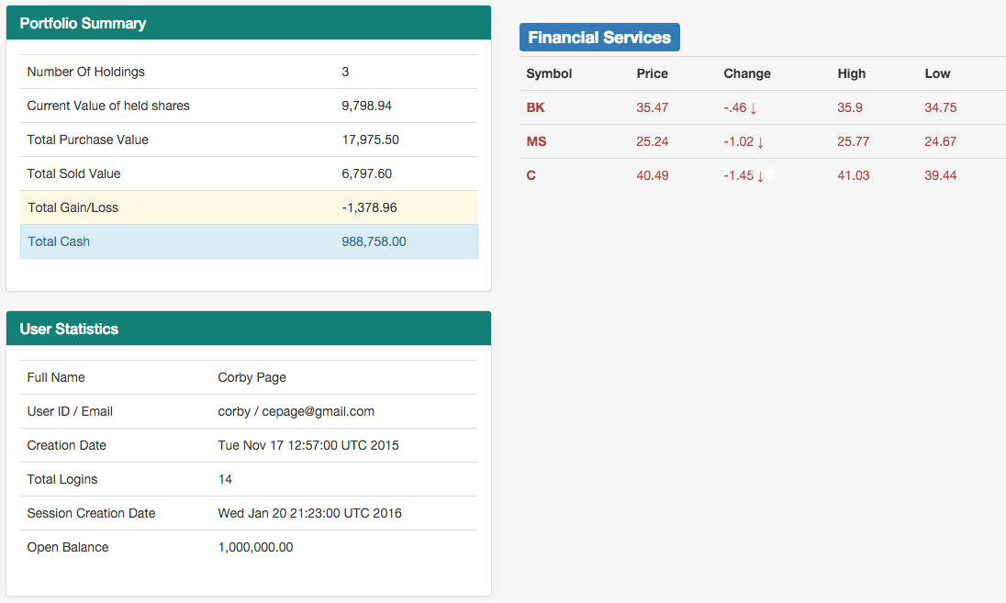
Spring Boot Trader
Reference Application
Download, Deploy, Run
http://tinyurl.com/boot-trader

Slide 20
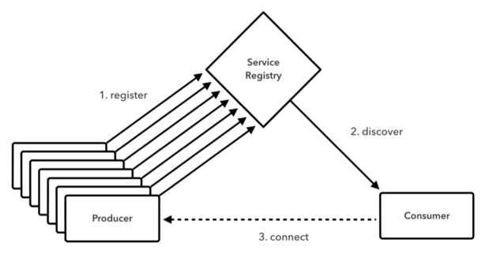
Service Discovery
Uses Service IDs, not URLs, to locate services
Client-side or server-side load balancing

Slide 21
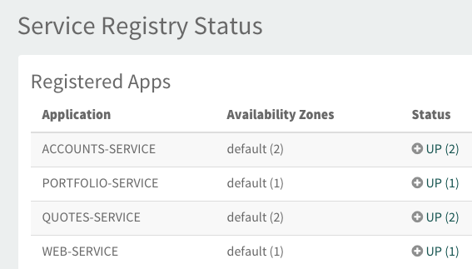
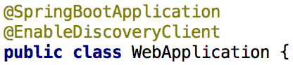
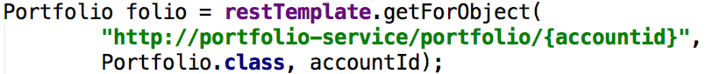
Service Discovery
Code
Manage

Slide 22
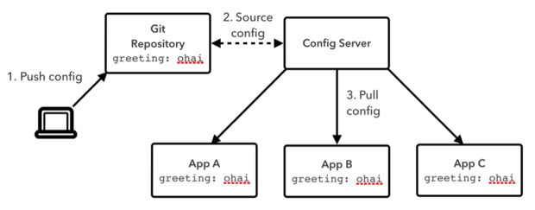
Config Server
Local or remote Git repositories
Configuration specified by environment, service, or system

Slide 23
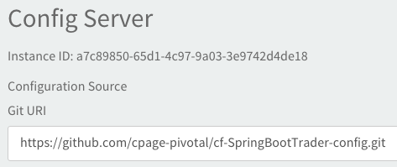
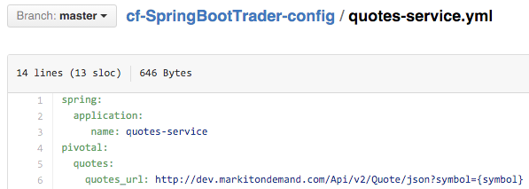
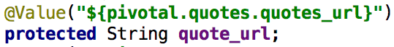
Config Server
Code
Manage

Slide 24
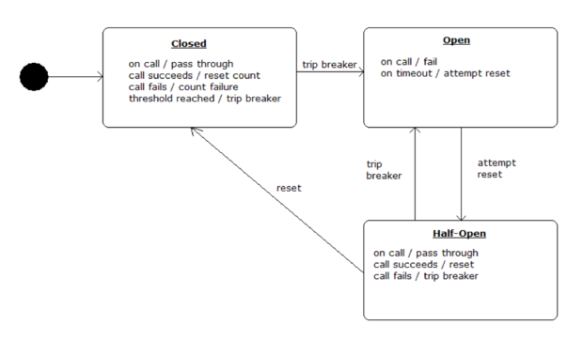
Circuit Breaker
Safe fallback limits liability of failure
Smart throttling reduces invocation of failed services

Slide 25
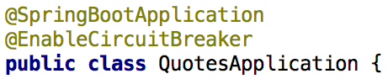
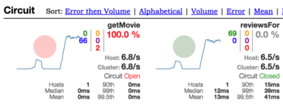
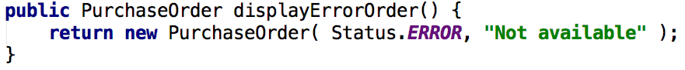
Circuit Breaker
Code
Manage

Slide 26
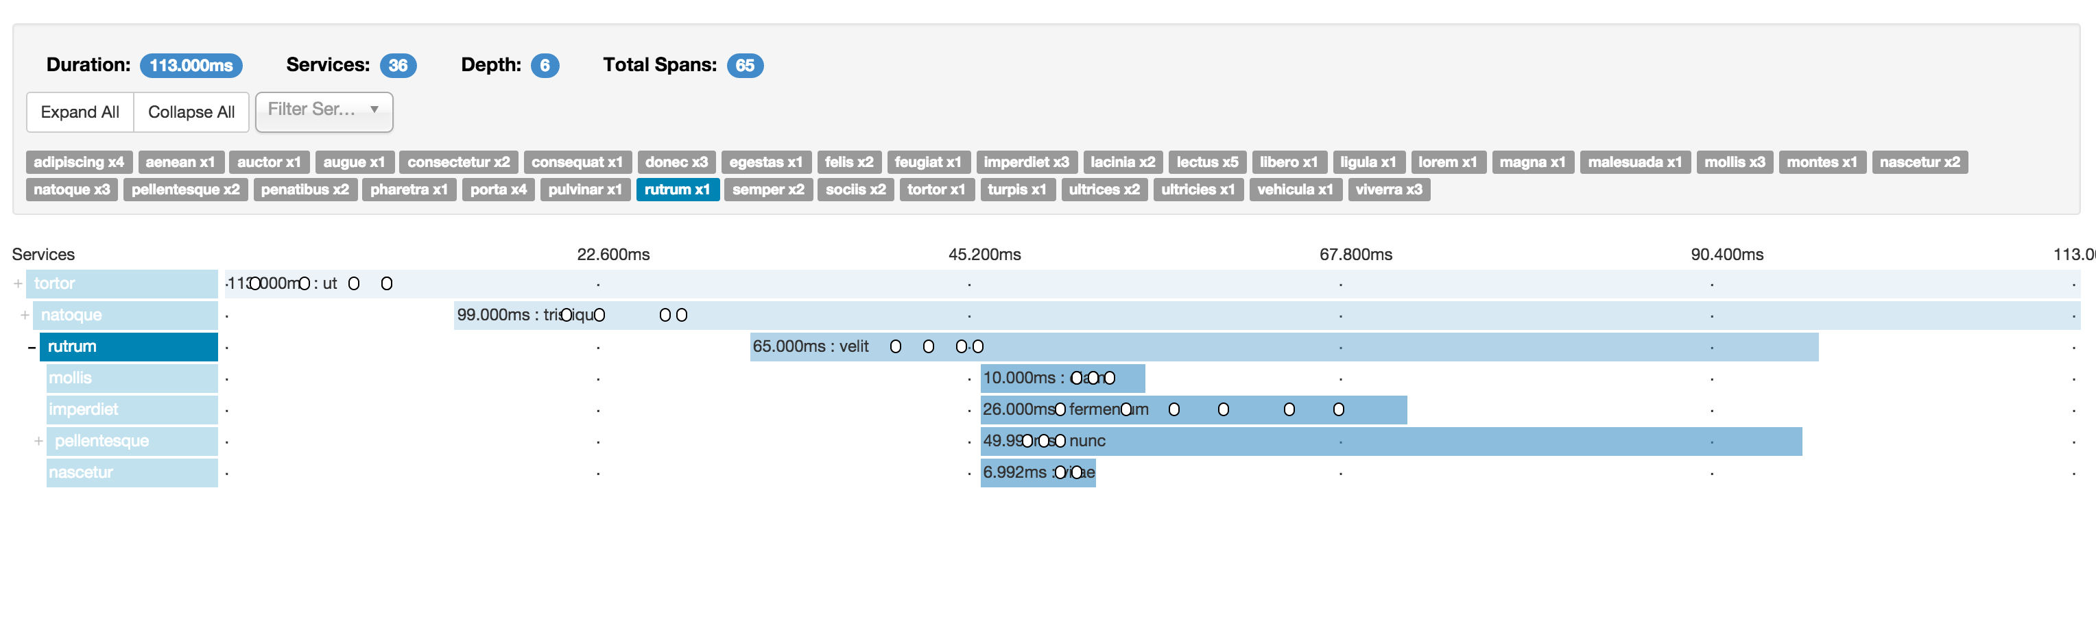
Future: Spring Cloud Sleuth
Distributed Tracing for the Cloud. Invocations are captured in logfiles, remote collector services, and realtime Web UIs.

Slide 27
Spring Cloud Services
Battle-tested Infrastructure, Out of the Box
Highly available, Enterprise-class implementations
Integrated with the logging, monitoring, and administration capabilities of Pivotal Cloud Foundry

Slide 28
Open.
Agile.
Cloud-Ready.

